Slide 1

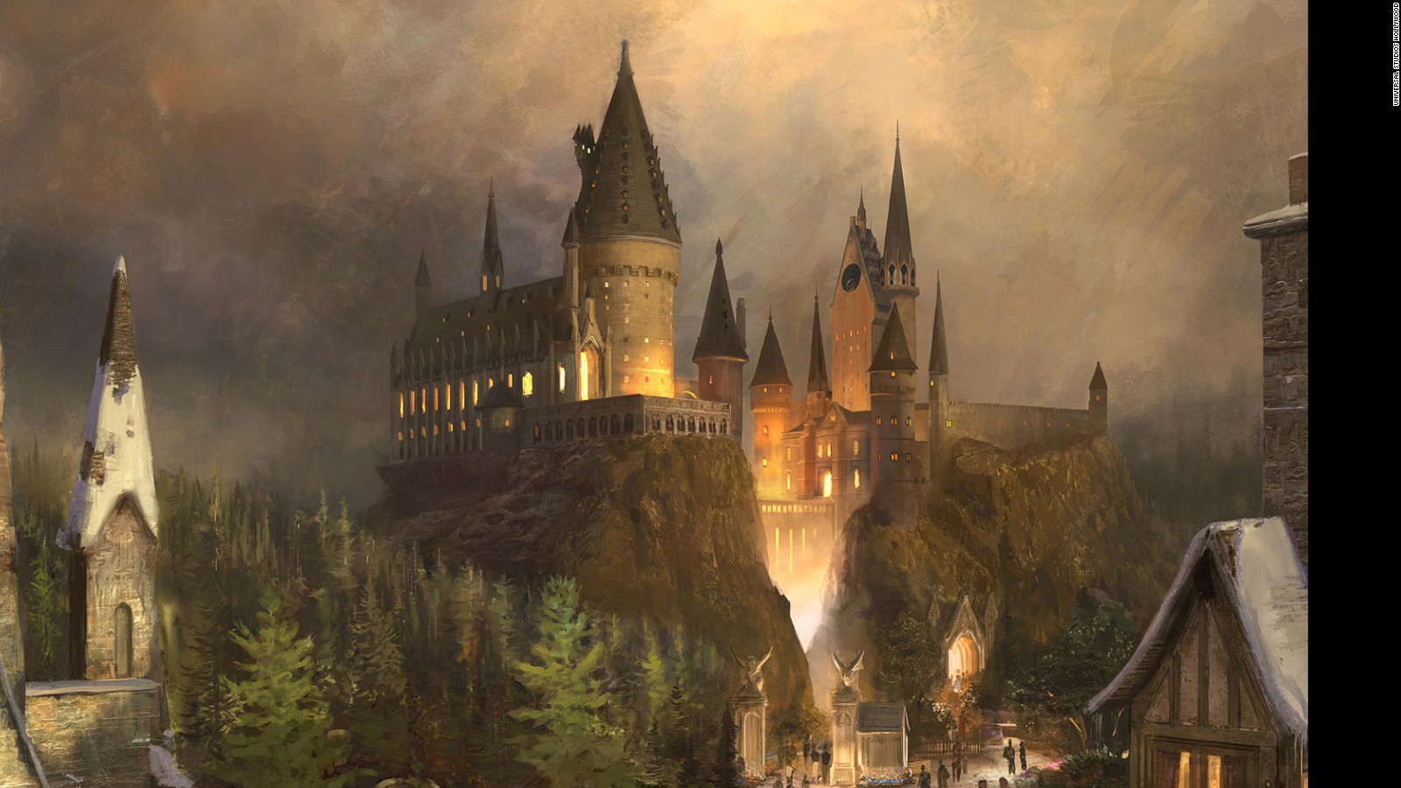
Deathly Hallows
Harry Potter
and the
PART ONE
The Role-Playing Game
Presented by:
Ann Nguyen
Jong Shin
Kabir Manocha
Kwame Nyame-Kusi
Luqing Qi
Notes:
Kwame

Slide 2
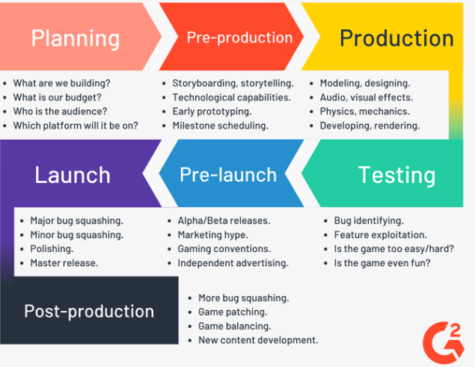
Stages of game development
Planning
Pre-production
Production
Testing
Pre-launch
Launch
Post-production

Slide 3
A DATA-DRIVEN R.P.G.
Our mission and How we approached.
01
What we need and what we found in order to build a role-playing game.
02
A new Role-playing Game based on the movie.
03
Notes:
Kwame

Slide 4

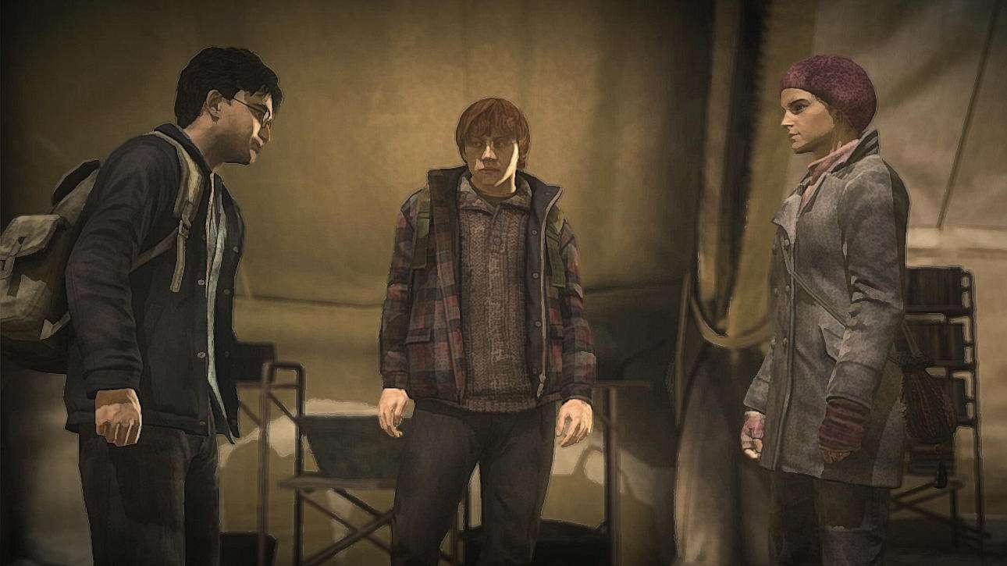
The Mission
01
Provide a Strategy
to build a R.P.G based on the movie data
Notes:
Kwame

Slide 5
Our Approach
01
A Data-Driven Game Making Process
Find out the main characters – Social network analysis
Overall mood/tone of the game – Sentiment analysis
Dialogues of the characters – Word frequency
Diction/tone of the dialogues – Sentiment analysis
Character interaction – Frequency, Sentiment analysis
Notes:
Kwame

Slide 6
Main Characters
02
Find out the main characters from the movie script
Social Network Analysis
Type of libraries we used
igraph, tidyverse
Social network graphs with main characters
Classify characters in groups
Notes:
Luqing

Slide 7
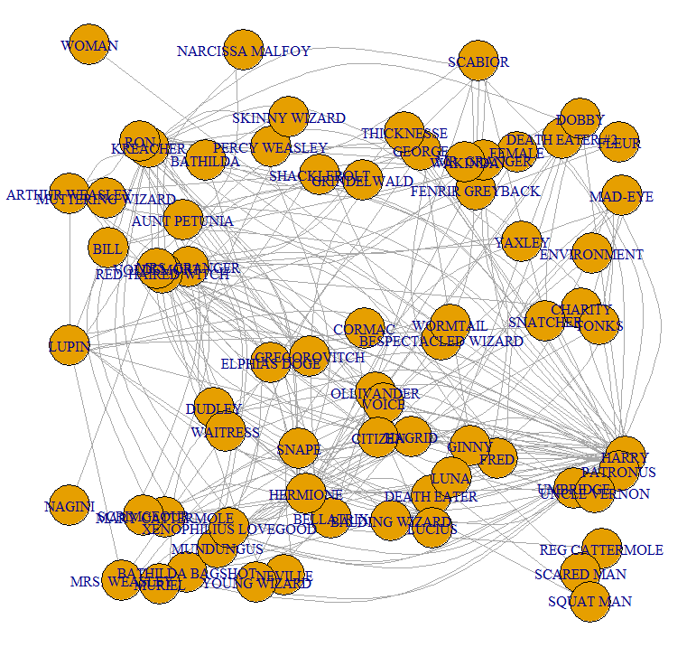
02
Notes:
Luqing

Slide 8
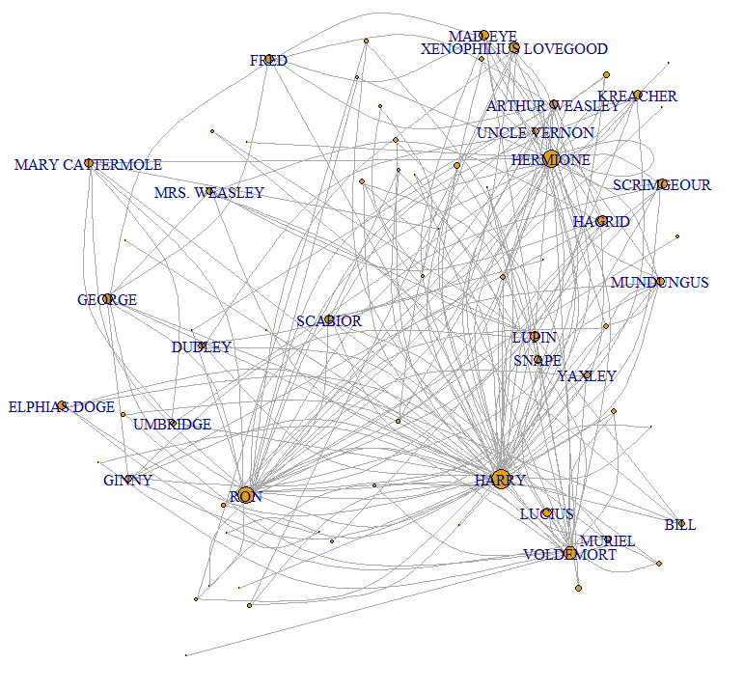
02
Notes:
Luqing

Slide 9
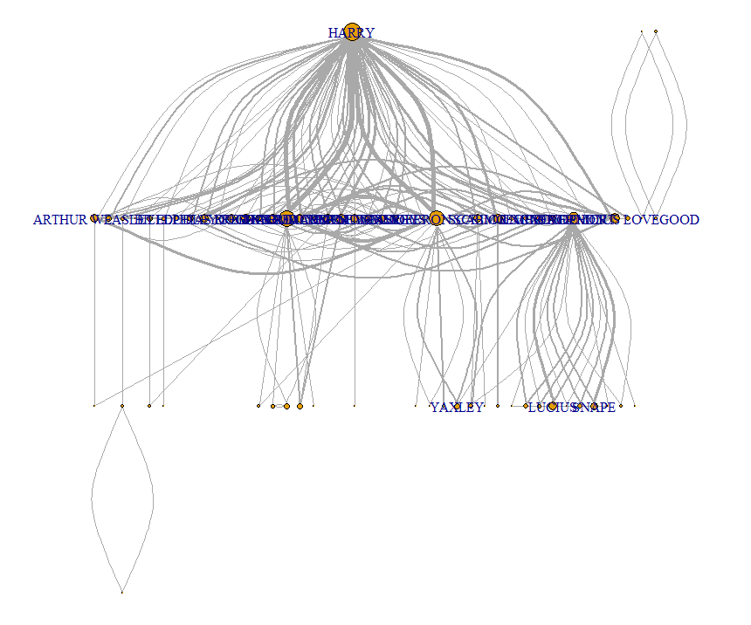
02
Notes:
Luqing

Slide 10
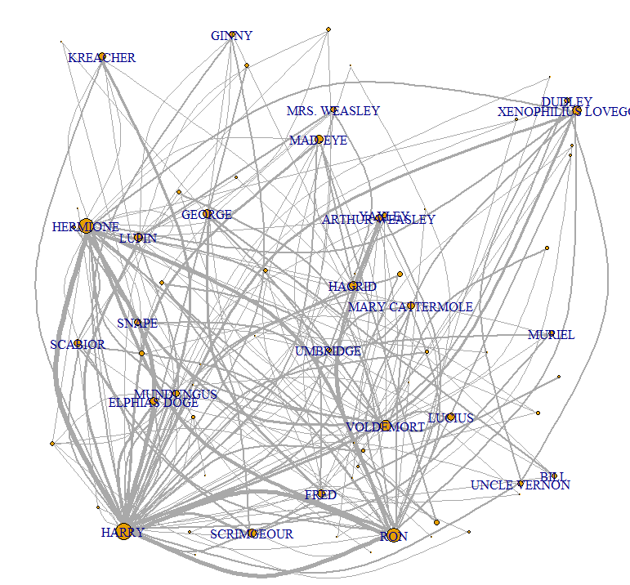
02
Notes:
Luqing

Slide 11
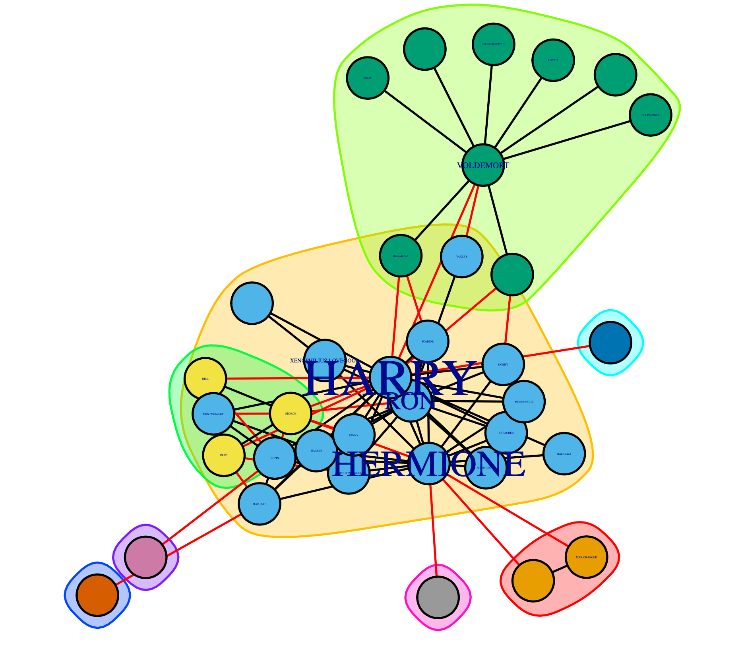
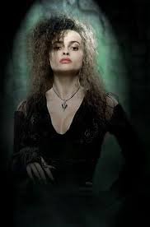
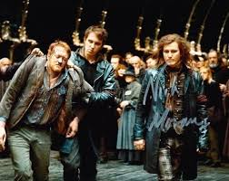
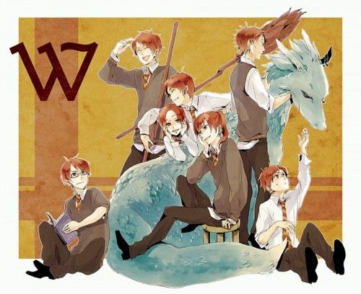
Good vs. Evil
02
02
Notes:
Luqing

Slide 12
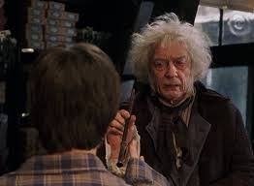
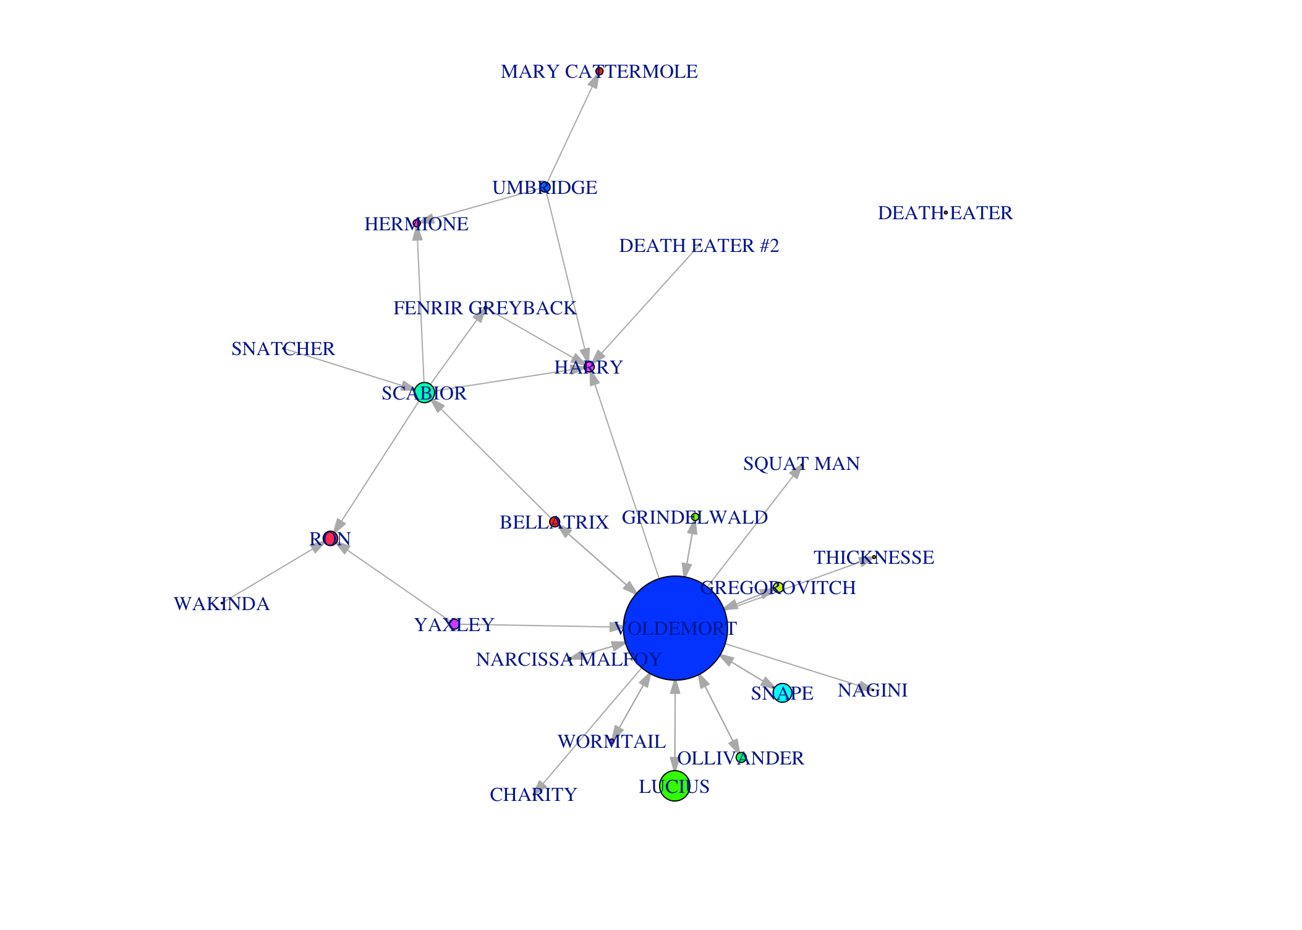
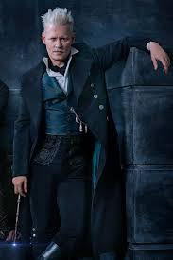
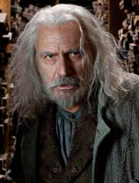
Evil
02
Notes:
Luqing

Slide 13
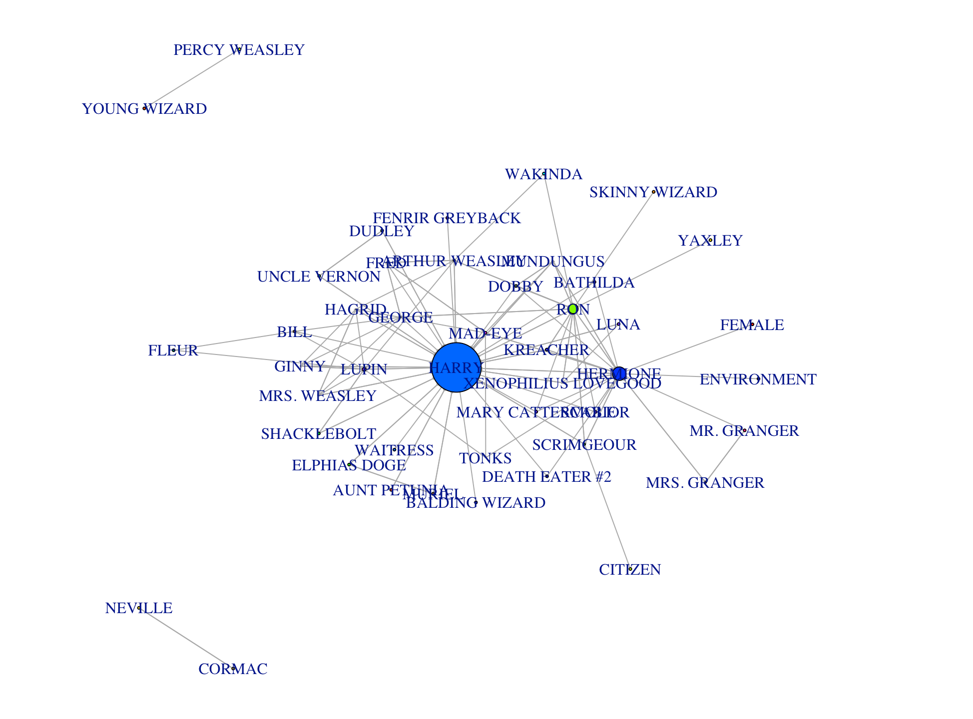
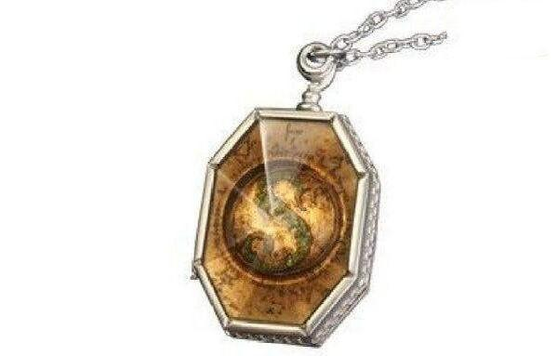
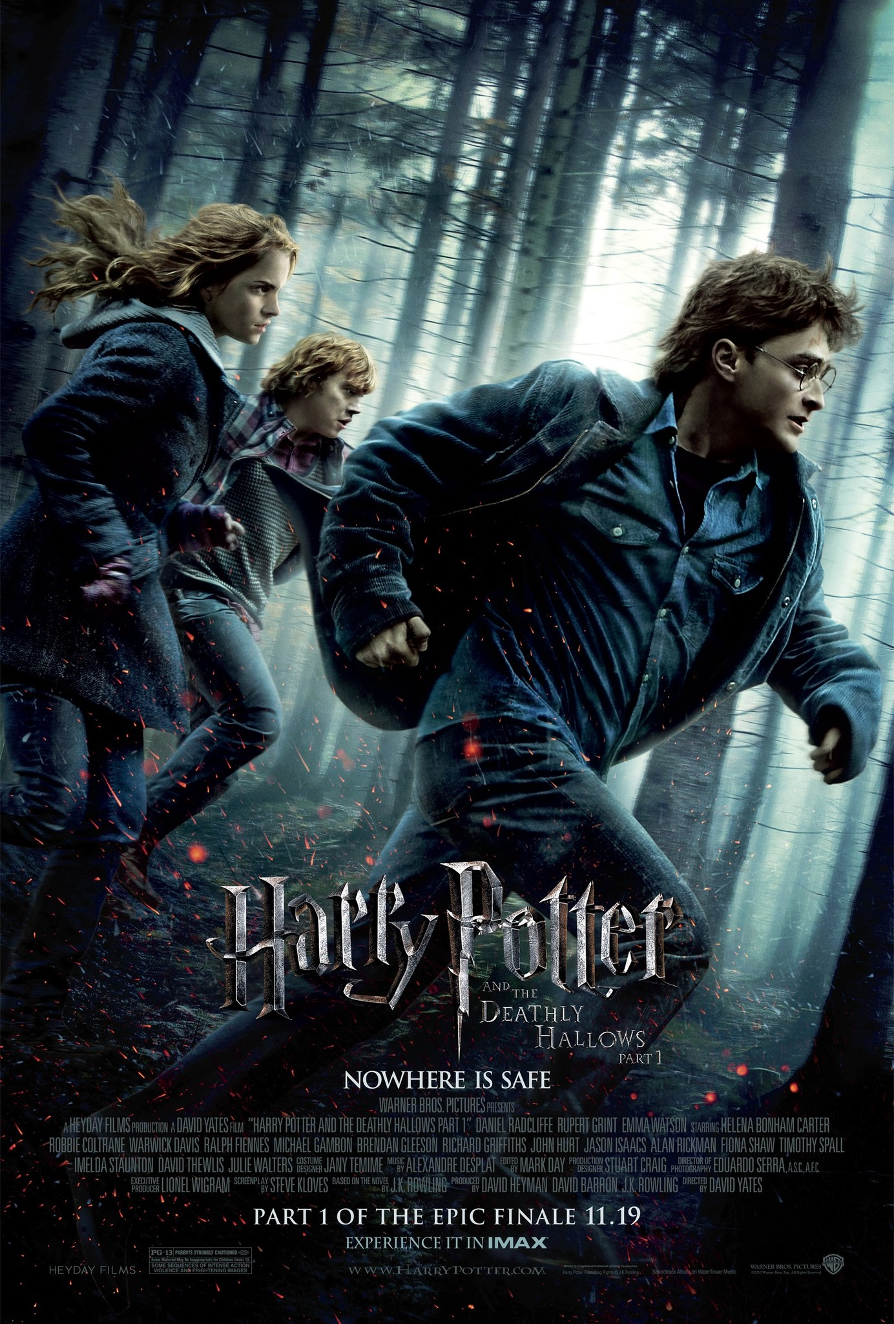
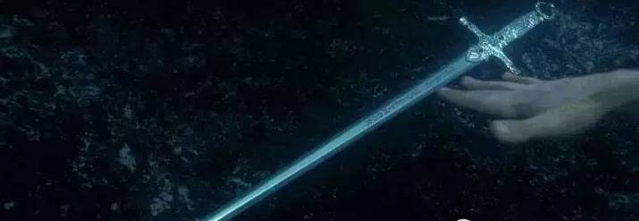
Good
02
Notes:
Luqing

Slide 14
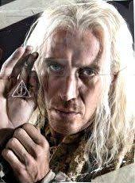
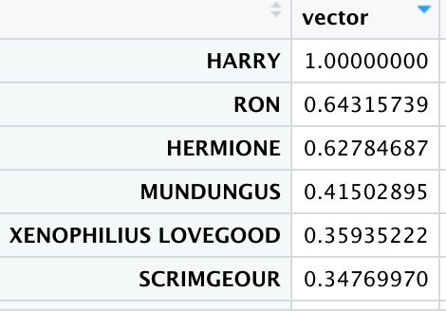
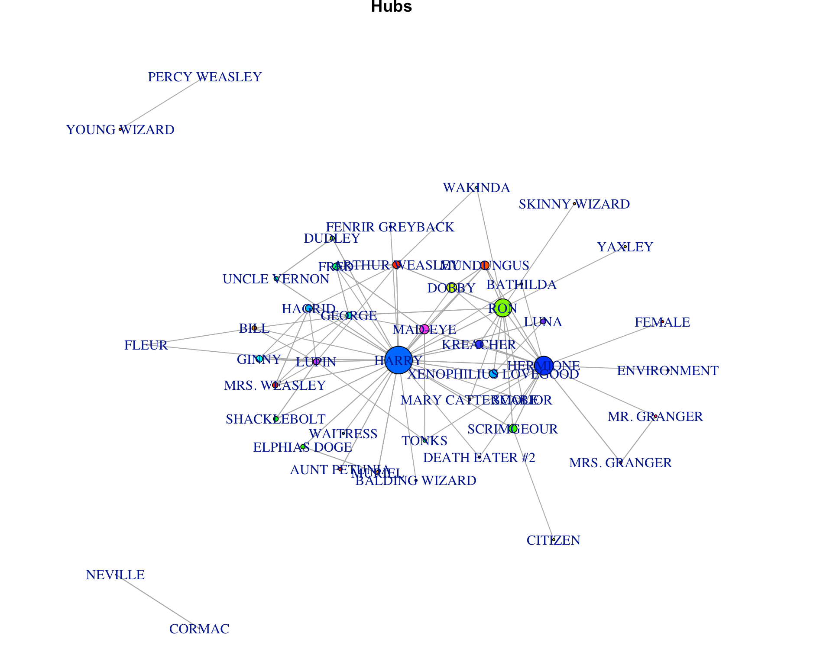
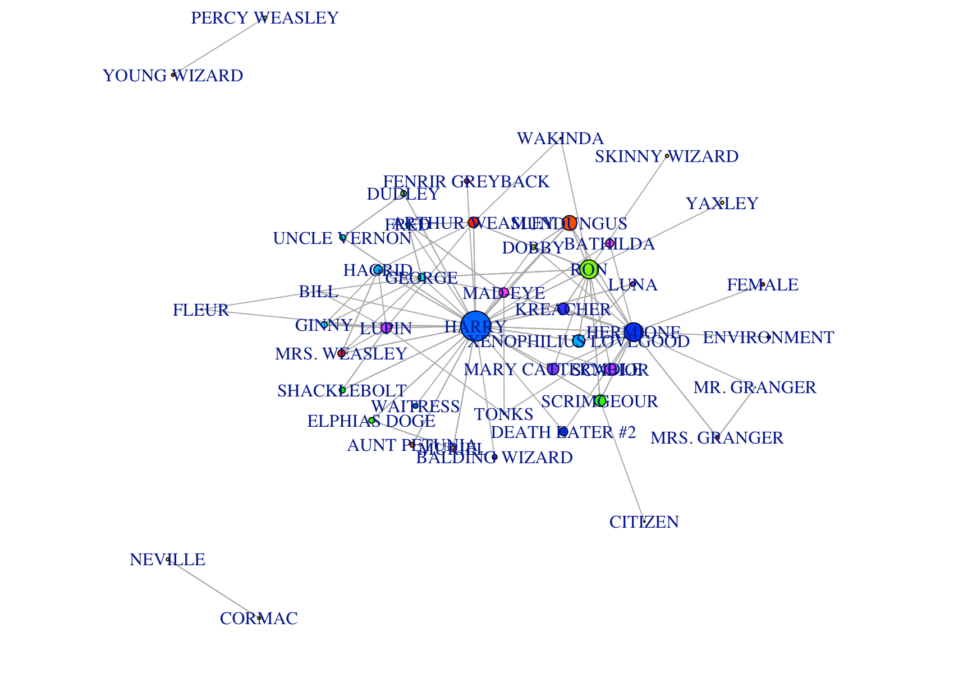
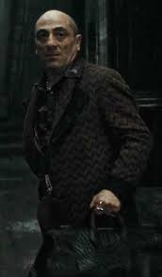
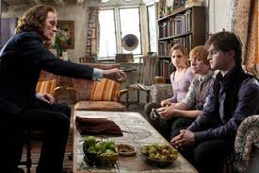
Hubs and Authorities for Good
02
Eigencentrality
Notes:
Luqing

Slide 15
Tones in Story Lines
02
Developing the mood for the story lines for the game
Provide the data of overall sentiments in the movie script.
Sentiment Analysis of overall scripts
Types of libraries and lexicons we used
Wordcloud
NRC
Bing, Loughran and Afinn
Combined scores
Notes:
Jong

Slide 16
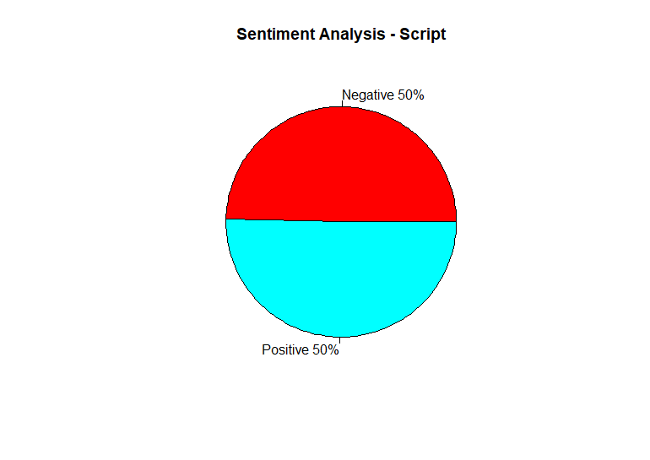
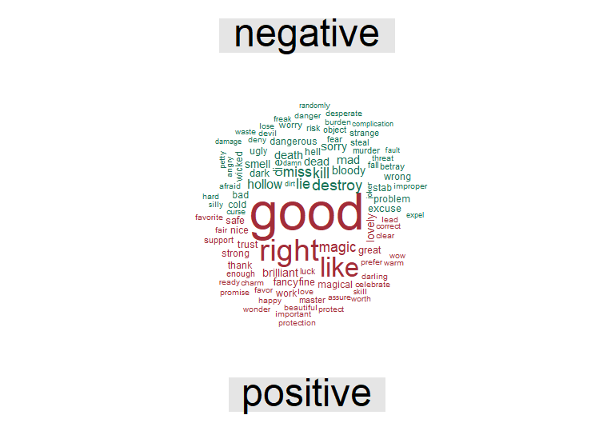
Sentiment Analysis - Script
02
Notes:
Kabir

Slide 17
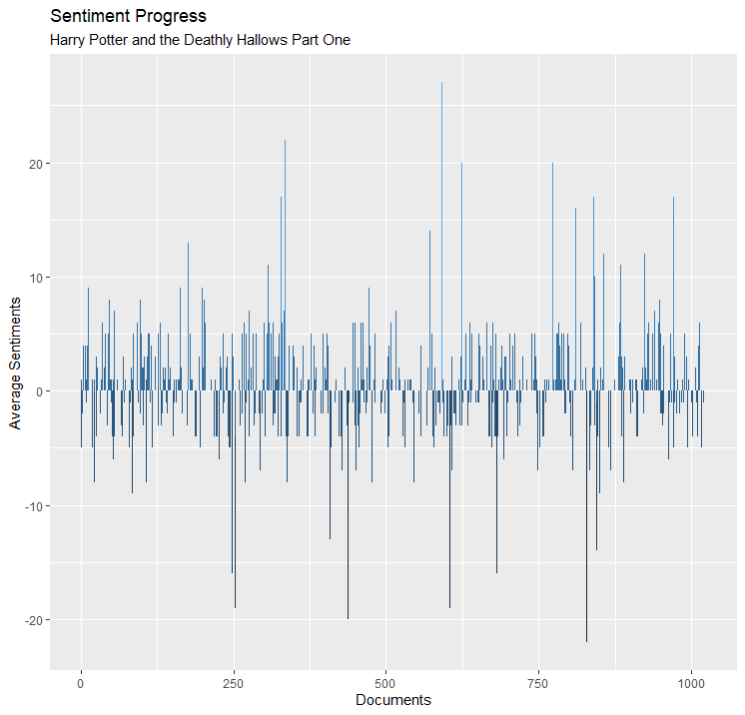
Story Lines
02
Notes:
Jong

Slide 18
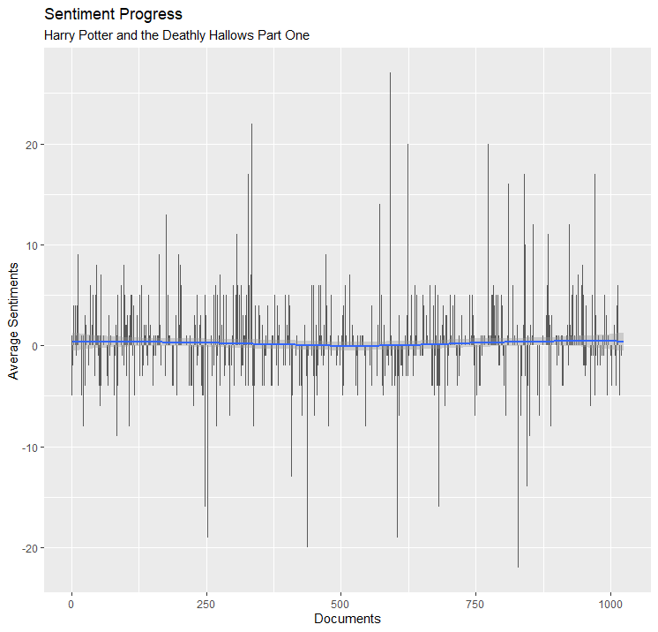
Story Lines
02
Notes:
Jong

Slide 19
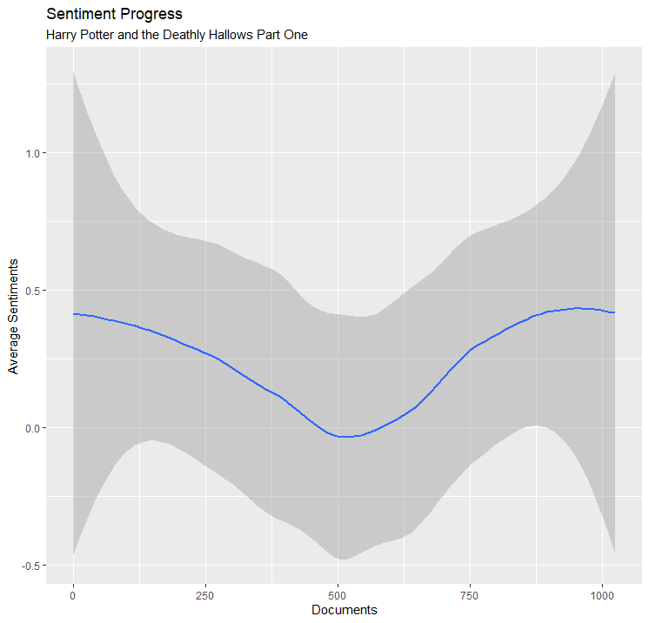
Story Lines
02
Notes:
Jong

Slide 20
Dialogues of the Characters
02
Developing the dialogues of characters in the game
Provide the data of words that are frequently used in the movie script.
Word frequency Analysis
Notes:
Jong

Slide 21
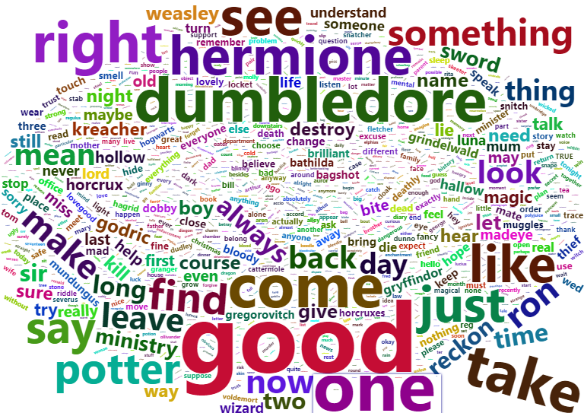
Word Cloud
02
Notes:
Jong

Slide 22
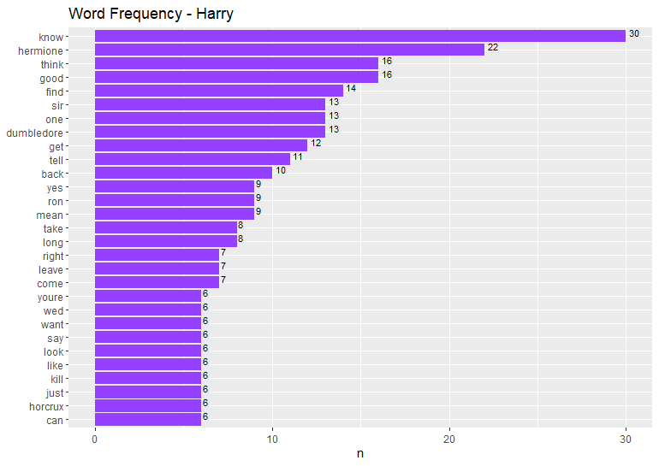
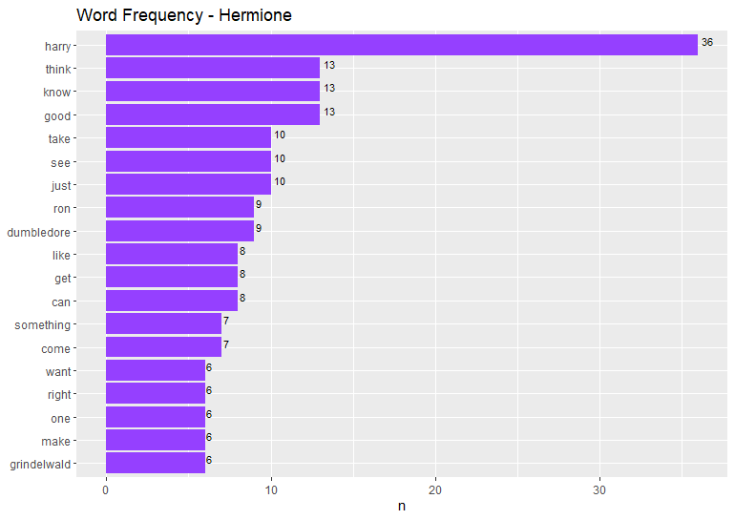
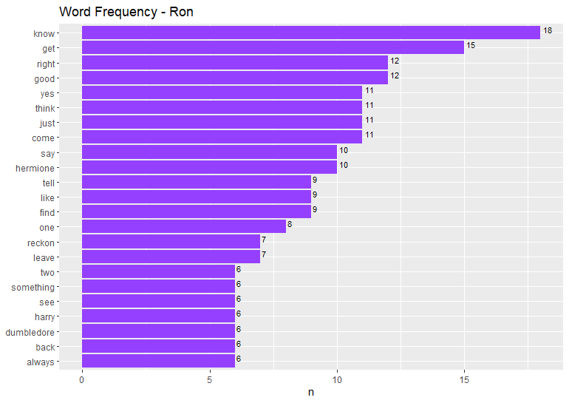
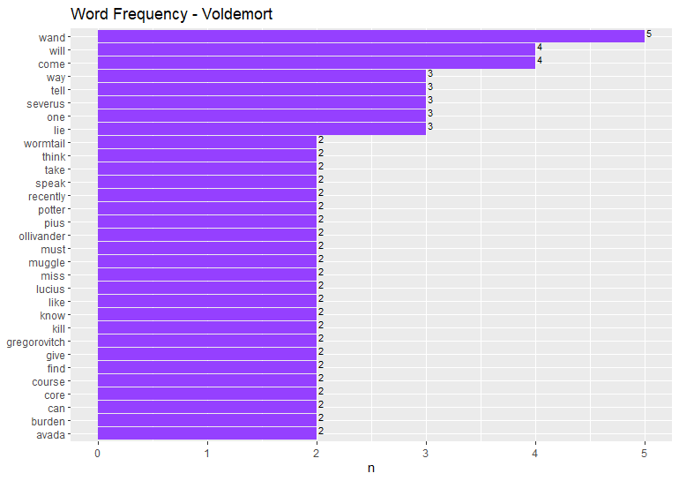
Word Frequency Analysis
02
Notes:
Jong

Slide 23
Diction and Tones
02
Sentiment Analysis of each character’s narration in the movie
Understand diction and tones of dialogues for role playing game
How to develop player roles based on character sentiments
Notes:
Kabir

Slide 24
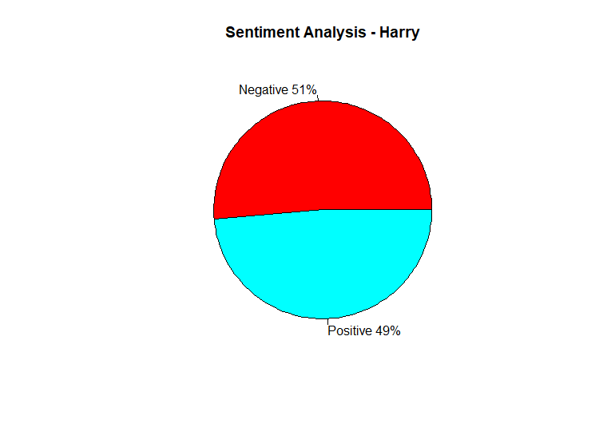
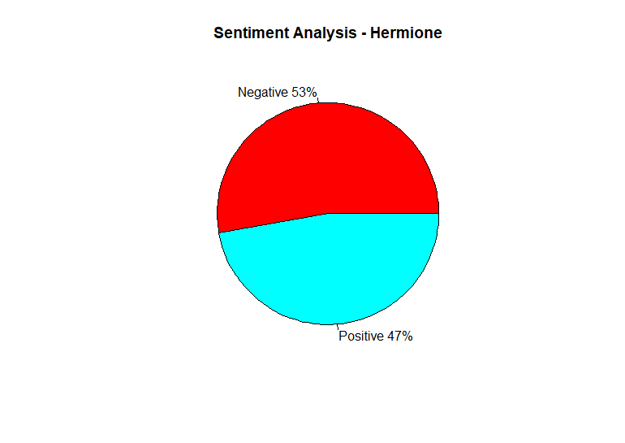

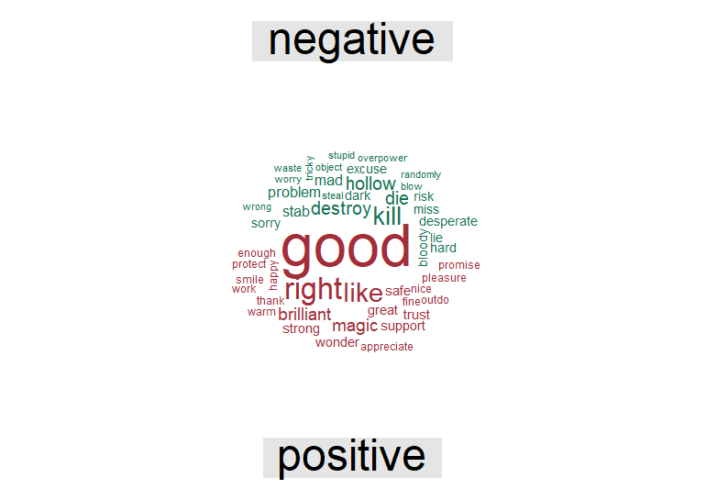
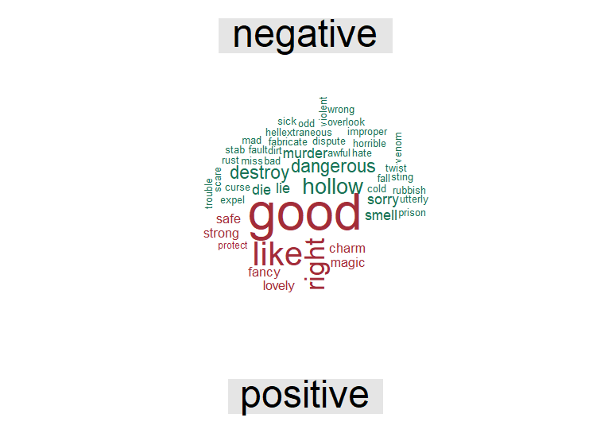
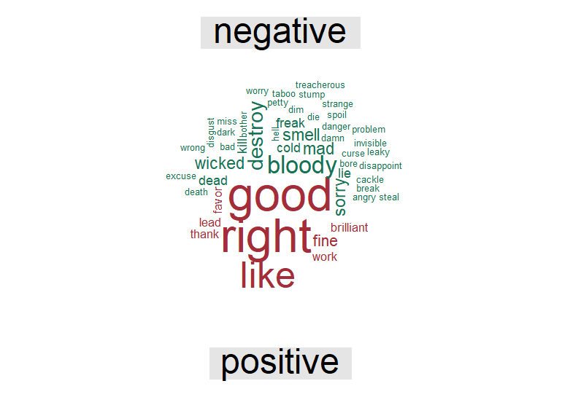
Sentiment Analysis (Main Characters)
02
Notes:
Kabir

Slide 25
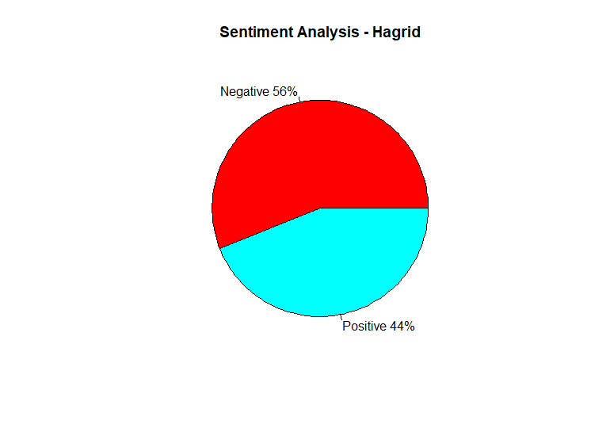


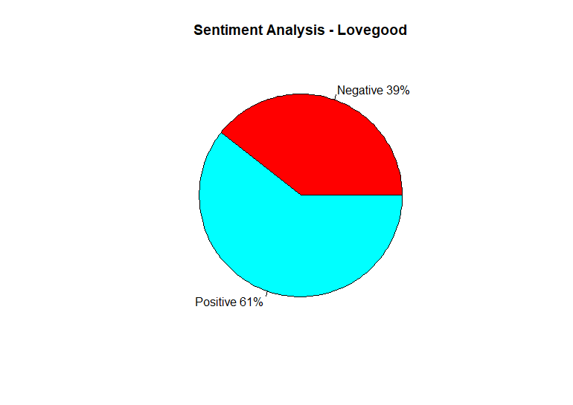
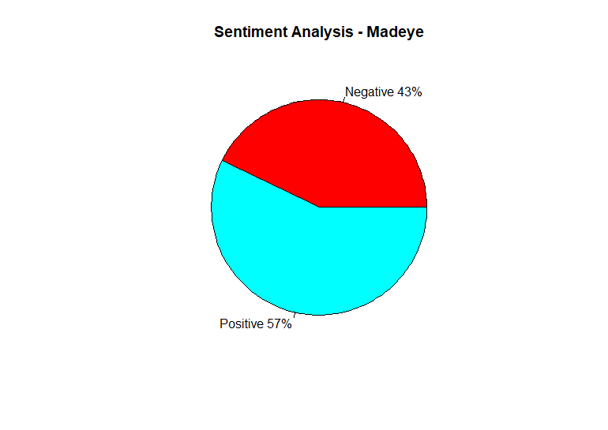
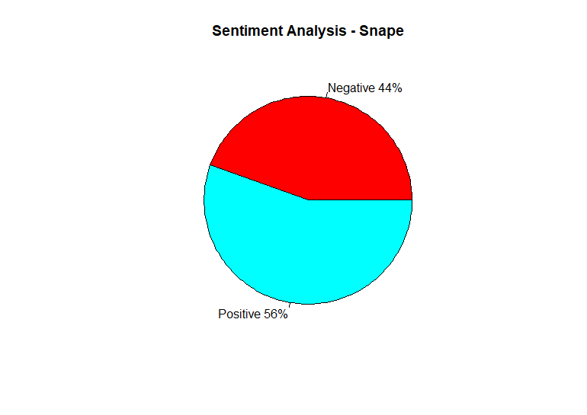
Sentiment Analysis (Antagonist and Supporting Characters)
02
Notes:
Kabir

Slide 26
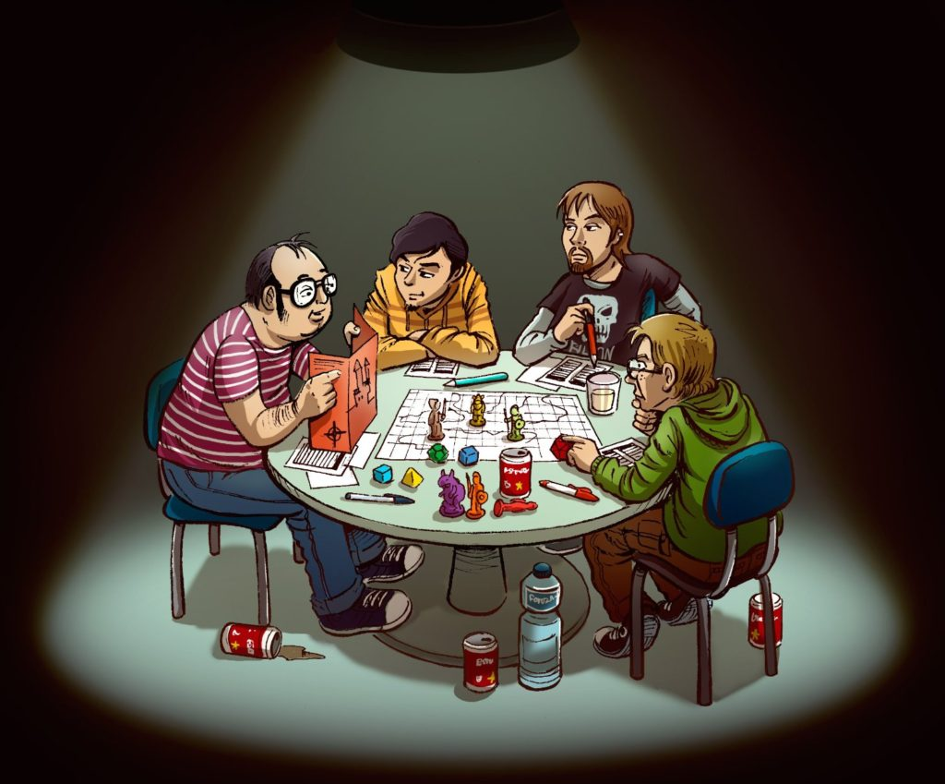
Interactions
02
Sentiment Analysis between the characters
Determine player controls and actions based on character interactions
Notes:
Kabir
https://innonlakewissota.com/4-reasons-to-host-a-role-playing-game-retreat-at-a-bb/

Slide 27
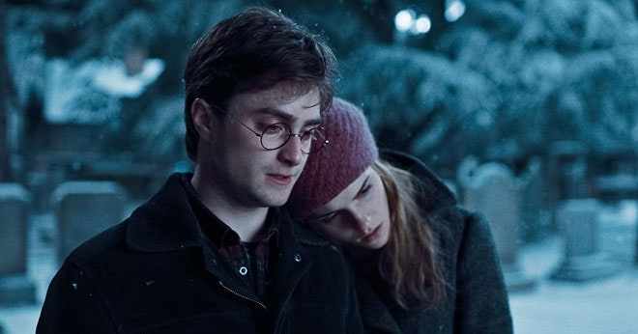
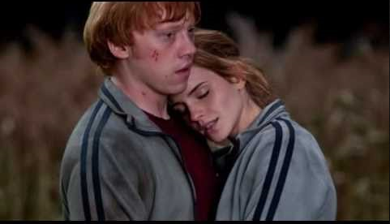
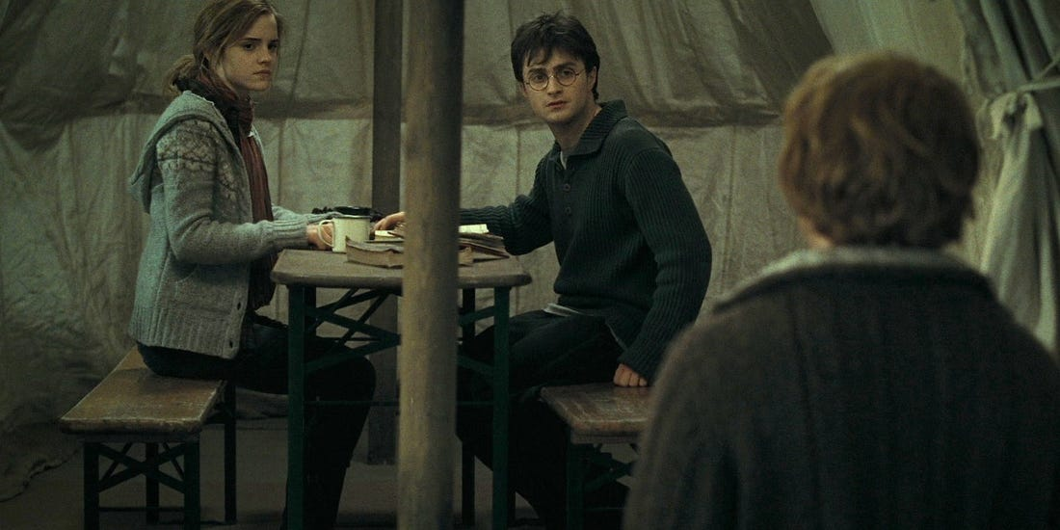
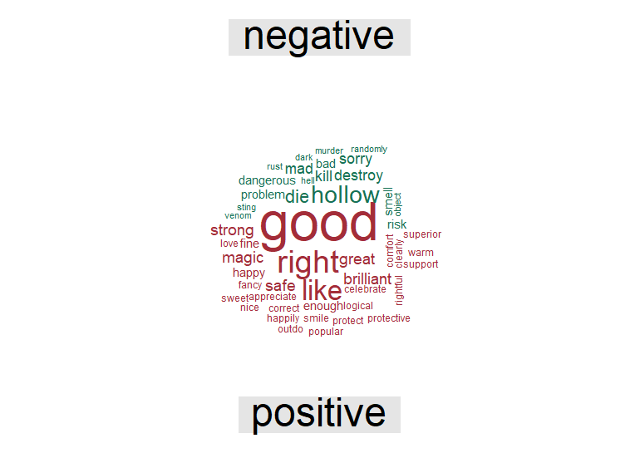
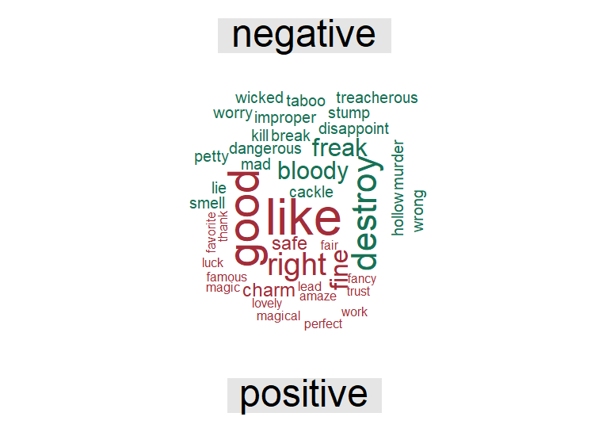

Interactions (using bing lexicon)
02
Notes:
Kabir

Slide 28




Interactions (using sentimentr package)
02
Mean | 0.02391
Median | 0
Result | Right skewed
Mean | 0.01448
Median | 0
Result | Right skewed
Mean | - 0.0269
Median | 0
Result | Left skewed
Notes:
Kabir

Slide 29
Game Insights - Sentiment Analysis
02
86% words are Neutral. 7% Negative and 7% Positive
Character Analysis: Harry – Positive, Hermione and Ron – Negative
Character Interaction Analysis:
Harry-Hermione and Hermione-Ron: Positive
Harry-Ron: Negative
Overall script is balanced in negative and positive sentiments
Notes:
10k+ words neutral
Harry was –ve in nrc
Kabir

Slide 30
Stitching the Data for R.P.G
03
Role playing of the characters in the game
Combining the data analyzed
Adapt the concept of data stitching methodology
Notes:
Anh
Since this is a role playing game, we’ve tried to provide the data of what actions or words, for each character, can be considered based on the analysis we’ve performed.
In order to do that, we’ve adapted the concept from data stitching methodology which was invented by Dr. A.

Slide 31
Harry Potter
03
In the beginning part of the game when Harry is talking to Hermione:
Overall Story Line
Harry’s Sentiment
Story is slightly Positive (Beginning)
Good
Brilliant
Great
Thank
Promise
Harry is slightly Negative
Positive interaction with Hermione
Word Frequency
Interactions
Notes:
Anh
For example, for Harry Potter, using the data stitching concept, we are able to figure out what word Harry can use in what tone in a certain situation of the game.
Let’s say, it is the beginning of the game when everyone is gathered to escape to the safe house, Harry is talking to Hermione.
The overall sentiment in the beginning part of the game is slightly positive, also considering Harry’s overall sentiment throughout the movie is slightly negative but interaction with the Hermione is positive.
The suggested words that can be used for Harry in the situation to Hermione is Good, Brilliant, Great, Thank, Promise and etc. With the tone of positive or hope.

Slide 32
Application
03
Social network and Sentiment Analysis combination
Help with appropriate content building process in RPG .
Apporiate age-limitation , identify target customers
Build different version for different age-group
Age limit 14-15 due to violent content , extreme feeling , sadness, and dark part.
Notes:
Anh

Slide 33
Questions
The relationship between sentisement and revenue
"In terms of inflation-adjusted domestic grosses, they are ranked: Sorcerer’s Stone ($526 million), Deathly Hallows part II ($451 million), Goblet of Fire ($426 million), Chamber of Secrets ($423 million), Order of the Phoenix ($400 million), Half-Blood Prince ($381 million), Prisoner of Azkaban ($379 million) and Deathly Hallows part I ($349 million).
Unusually low-grossing installment (Prisoner of Azkaban) and the unusually high-grossing chapter (Deathly Hallows part 2)
https://www.forbes.com/sites/scottmendelson/2020/08/13/harry-potter-movies-ranked-box-office-jk-rowling-emma-watson-daniel-radcliffe/?sh=37c35e7152da
Notes:
Anh

Slide 34
Appendix
Sample of R.P.G

Slide 35

Deathly Hallows Part One
Log In

Slide 36
Dumbledore’s Army
Harry Potter
The funder of Dumbledore’s Army .
Magical abilities and skills
Defense Against the Dark Arts
Parseltongue
- Insight into Voldemort’s mand
Artifact : Clock of invisibility
Godric Gryffindor’s Sword
Golden Snitch

Slide 37
Dumbledore’s Army
Hermione
“That’s what Hermione does. When in doubt , go to the library” -----Ron
-Magical aptitude
-Healing magic
-History of Magic
ARTIFACT :
The Tales of Beedle the Bard

Slide 38

Dumbledore’s Army
RON
"If you want to kill Harry, you'll have to kill us too!”
Leadership skills
Tactical thinking
Dark Arts
ARTIFACT :
Deluminator

Slide 39
The Dark Legion
Lucius Malfoy
very shrewd, opportunistic social climber who was good at controlling other
Ability
Dark arts
Intellectual giftedness

Slide 40

The Dark Legion
The Dark Lord
The most evil wizard in hundreds and hundreds of years.
Ability:
Magical mastery
Immortality
Wand Versatility
Artifact : Elder wand

Slide 41
The Dark Legion
Bellatrix Lestrange
“She was a witch, as Harry knew, with prodigious skill and no conscience.” ----Harry
Ability
Dark Arts
Indomitable willpower

Slide 42
Chapter one Rescue Dumbledore’s Army Harry Mission 1 Help Mid-eye make Polyjuice. Mission 2 Help Hagrid control the motorbike and avoid attack the attack from the Dark Lord. Mission 3 Pass the test Minister for Magic Scrimgeour to release the contents of Albus Dumbledore’s will Mission 4 Interrogate Mundungus about the true Horcrux.

Slide 43
Chapter one Wizard without a wand The Dark Legion Lucius Mission 1 Volunteer to offer your wand to the Dark Lord Mission 2 Help other Death Eaters kill the Mad-eye. Mission 3 Help the Dark Lord tourrching Ollivander.

Slide 44
Chapter Two Horcrux Hunt Dumbledore’s Army RON Mission 1 Interrogate Mundungus about the true Horcrux. Mission 2 Infiltration Ministry of Magic get the true Horcrux. Mission 3 Help Harry get the Gryffindor’s sword and destroy the Horcrux.

Slide 45
Elder wand The Dark Legion The Dark Lord Mission 1 Tourrching Ollivander get information about Elder wand. Mission 2 Torturing and murdering both Gregorovitch and Grindelwald to finish the research. Mission 3 Broke into Dumbledore’s grave and robbed it of the wand.

Slide 46
Chapter 3 Deathly Hollows Dumbledore’s Army Hermione Mission 1 Go to Godric’s Hollow find the Gryffindor’s Sword. Mission 2 Asked two friends to visit Lovegood’s home, learn about Deathly Hollows Mission 3 Hit the Harry’s face before the Snatchers capture them.

Slide 47
The Dark Legion Bellatrix Mission 1 Incapacitating the snatchers and get back control of sword of Gryffindor Mission 2 Isolated Hermione for interrogation. Mission 3 Kill the Dobby.

